Slide 1
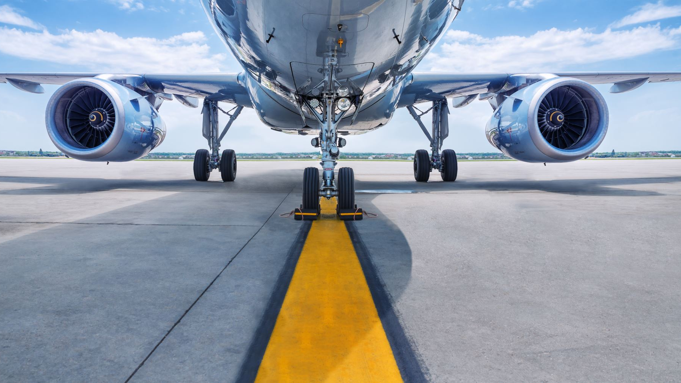
Becoming a commercial pilot
presented by Armin Schneider

Slide 2


Overview
Where do I start?
Will I get a job?
How much will it cost?
What’s the training like?
Pilot selection
Do I need a degree?

Slide 3
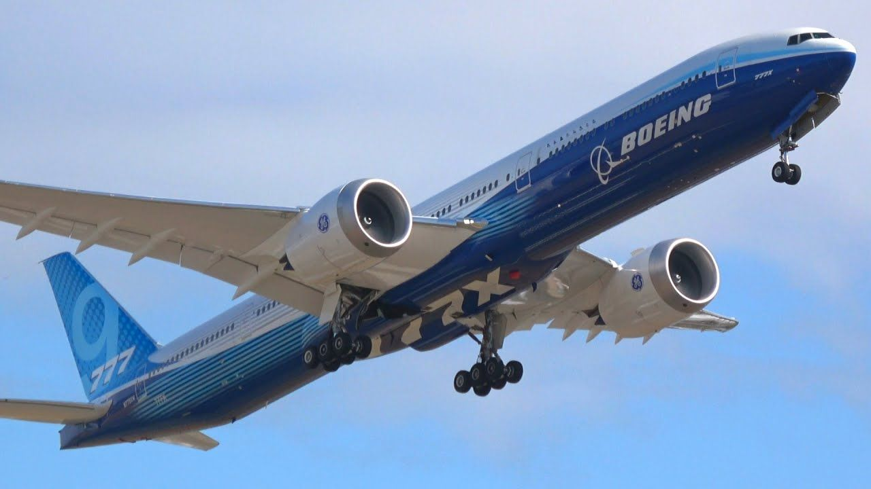
Where do I start?
Class 1 Medical is necessary
You can fly with glasses
You have to be at least 21 years old
You need to have a medical examination
Financial commitment and very competitive
Work placements with aviation companies

Slide 4
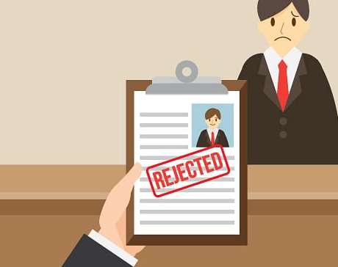
Will I get a job?
Boeing’s “Pilot and Technician Outlook” project
790,000 new Pilots needed
1/3 of these in Asia
206.000 in America
146.000 in Europe
Change on pilots’ age regulations

Slide 5

How much will it cost?
Be prepared to pay around 77.300€ to 132.500€
You can take a loan
Work through the training
Ask your parents for financial support
Risky investment

Slide 6
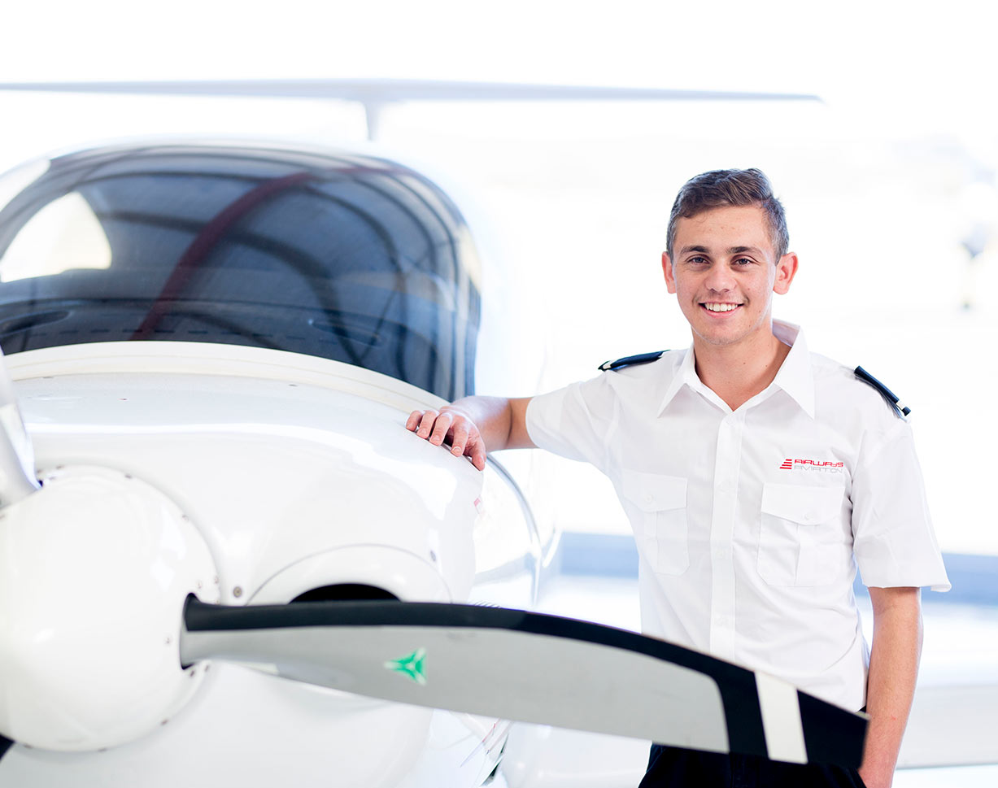
What’s the training like?
The ATPL ground exams
Flight training
Night rating
Commercial Pilot License
Multi-engine rating
Instrument rating
Multi-Crew Co-operation

Slide 7

Pilot selection
You have to...
pass multiple selection test
work in a team
demonstrate technical skills
show knowledge of the industry
You need to prepare
Prove that you are serious about that pilot career

Slide 8

Do I need a degree?
Cadet selections do not ask for one
Aviation-related degrees are becoming more popular

